Slide 1

IOT Analytics DOMAIN RESARCH AND EXPLORATORY ANALYSIS
Natalie Carreño

Slide 2






AGENDA
Background
Objective
Data
Recommendations
Partnership

Slide 3
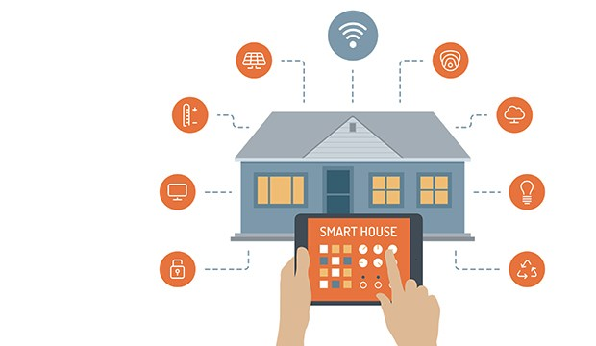
PROJECT BACKGROUND
DATA ANALYTICS
Apply data analytic techniques to data generated by devices such as smart homes, appliances, vehicles, electric meters
SMART ENERGY USAGE
Create models of patterns of energy usage by time and day of a year in a residence monitored by multiple sub-meters.

Slide 4
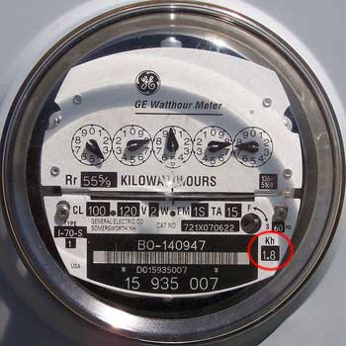



OBJECTIVE
Analyze power consumption data provided by the law firm. Client claims to have not been occupying a specific residence at the time of an undisclosed event during Summer of 2008.
Identify patterns of energy usage.
Analyze patterns to determine if these can be used to support client’s claims.
Identify any outliers or events that may undermine client’s claims.
Point out questions or recommendations.

Slide 5

DATA MANAGEMENT
We protect personal data using appropriate physical, technical, and organizational security measure. We give additional attention and care to sensitive personal data and respect local laws and customs, where applicable.
Access Control
Data Protection
Monitoring
User Management

Slide 6






Date
dd/mm/yyyy
Time
hh:mm:ss
DATA DESCRIPTION
Global Active Power
Household minute-averaged active power (in kilowatt)
Global Reactive Power
Household minute-averaged reactive power (in kilowatt)
Global Intensity
Household minute-averaged current intensity (in ampere)
Voltage
Minute-averaged voltage
Sub Metering 1
Dishwasher, oven and microwave
Sub Metering 2
Washing Machine, Tumble-drier, refrigerator and a light
Sub Metering 3
Water heater and air-conditioner
Data will be stored securely in hard drive
2,075,259 records

Slide 7
DATA ISSUES
MISSING VALUES
INCOMPLETE YEARS
TIME ZONE
1.25% of rows
Readings for April 28, 2007
2006 only has December data
2010 is missing December data
Time zone was converted to GMT

Slide 8



DESCRIPTIVE ANALYSIS
Sub Meter 3 has the highest average consumption with a mean of 6.448. This was expected because the heater and the air conditioner use the most power.
The highest reading was registered on Sub Meter 1 with a value of 82 and was recorded on 01/24/2009 at 12:51.
The highest reading in the laundry room has a value of 78 and was recorded on 1/17/2007 at 15:03.

Slide 9
DESCRIPTIVE ANALYSIS
During summer months, the highest reading on Sub Meter 3 was recorded on 6/24/2008 at 23:26. This reading also happened on 6/25/2008, 6/29/2008 – 7/2/2008.
During summer months, the highest reading on Sub Meter 1 was recorded on 7/12/2008 at 15:38 with a value of 79.
During summer months, the highest reading on Sub Meter 2 had a value of 75 recorded on 6/10/2009 at 13:21.

Slide 10

HIGH LEVEL RECOMMENDATIONS
Add Features
Outside Temperature
Air Conditioner Thermostat
Internet Usage
Range Gas Readings
Appliance sub-meter grouping
Refrigerator readings should be separated from sub-meter 2

Slide 11
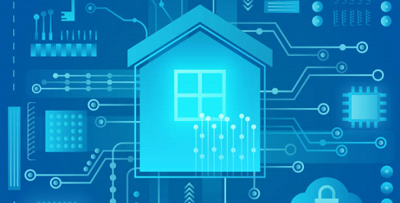
FUTURE BENEFITS OF DATA ANALYTICS
The use of data analytics can help determine if the client was in the residence at the time of the event.
Find patterns of energy consumption during seasons, month, week, day of the week.
Predictive models can be created to forecast power consumption.
Visualizations of patterns, consumption.

Slide 12

Thank you for your partnership!
“A satisfied customer is the best business strategy of all”. - Michael Leboeuf

